Slide 1
GCAM Assignment #5
ITM 20235575 안지석

Slide 2
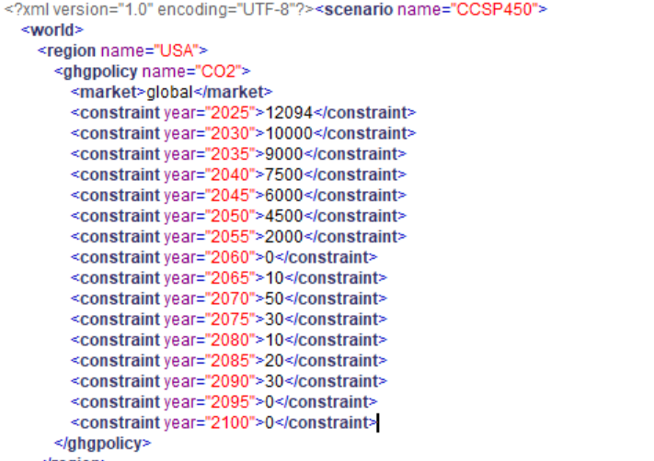
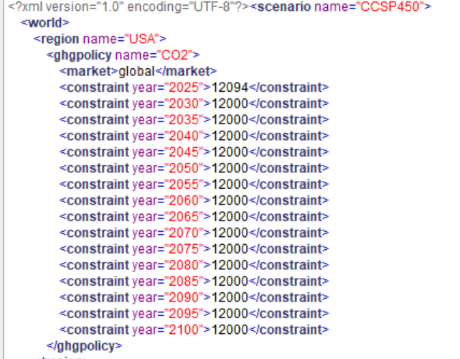
Intro
I ran two different scenarios, and for the plotting of the results, used R library called gcamextractor.
The only different constraints are as follows.
NZ2060 scenario
Reference scenario

Slide 3
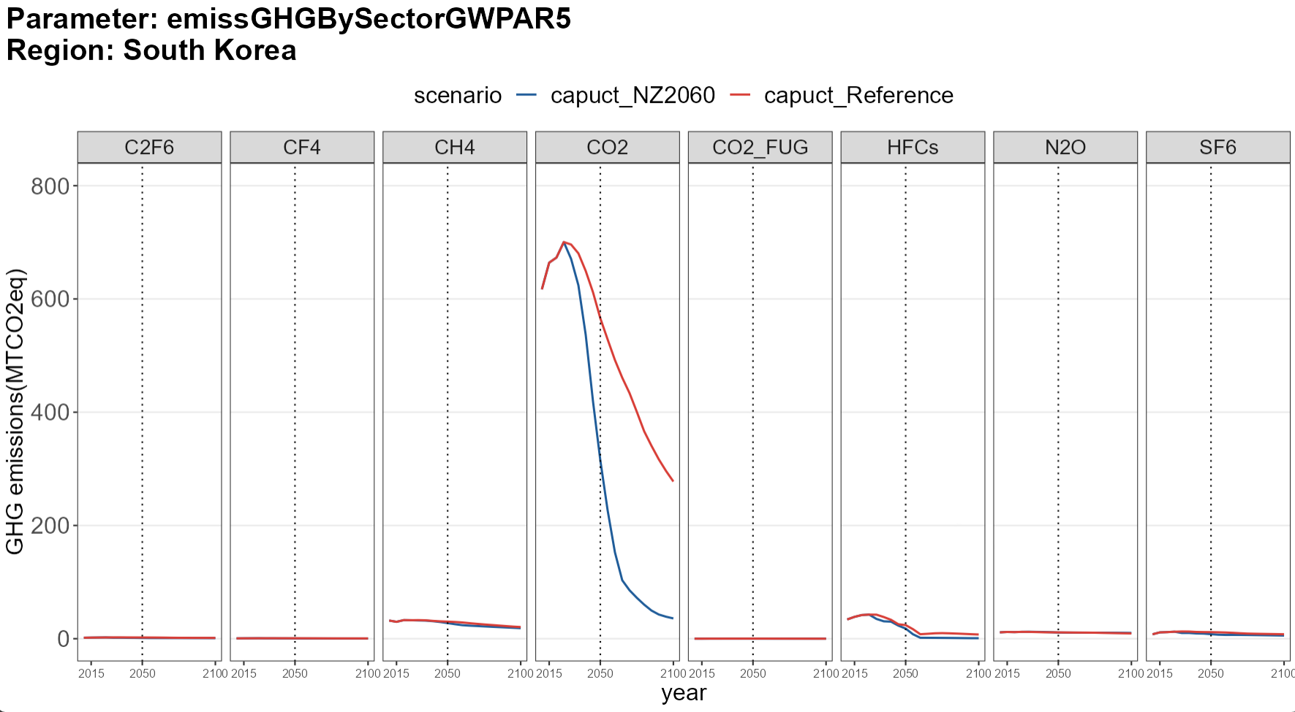
Which GHG is the hardest to reduce?
CO2 is the easiest to reduce, but not clear from the results that which sector is hardest to reduce.

Slide 4
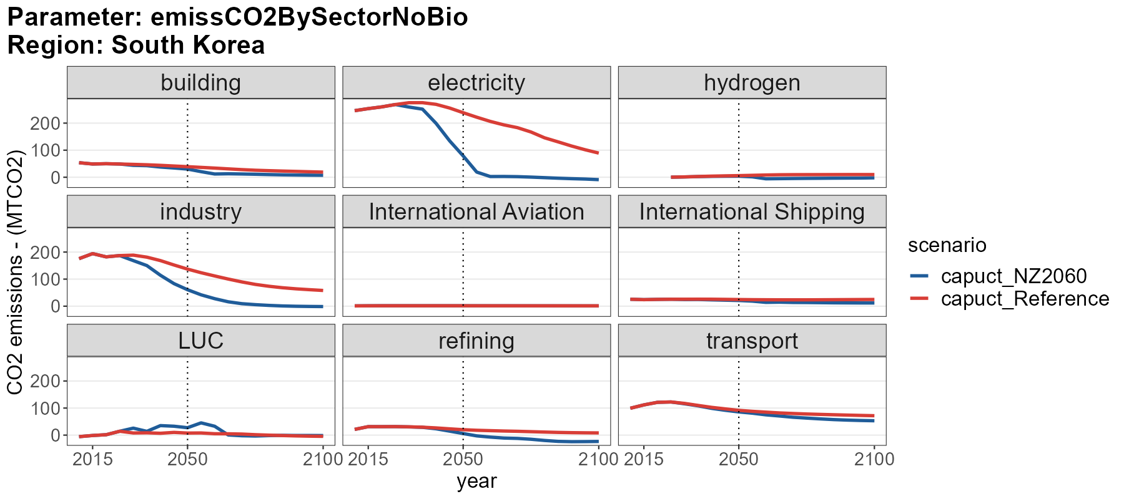
Which sector is the hardest to abate?
Electricity and industry sectors seem to be the easiest.
Transport sector seems to be the hardest one, given the high emissions compared to other sectors except electricity and industry.

